Slide 1


Daria Solodey
Methodist, course creator

Slide 2

Goal:
Пройти собеседование по soft skills
На уроке каждый участник должен:
включить камеру
настроить звук
активно участвовать
Notes:
Если вам не хватило места, вы можете здесь написать развернутый комментарий.

Slide 3

Lesson Plan:
Discuss the differences between soft and hard skills
Learn what verbs are better to use in the resume
Notes:
Развернутый комментарий.

Slide 4

Do you agree with this quote? Why (not)?

Slide 5

What are skills?

Slide 6
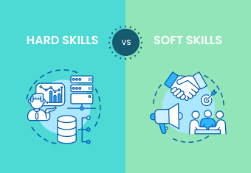
There are 2 kinds of skills:
What is the difference?

Slide 7
Match the type of skills and its definition. Give examples of soft/hard skills. Which skills are more important?
(people skills, social skills) abilities that can be applied in any job
are technical knowledge or training gained through any life experience in your career or education.
Hard skills
Soft skills

Slide 8
Match the type of skills and its definition. Give examples of soft/hard skills. Which skills are more important?
(people skills, social skills) abilities that can be applied in any job
are technical knowledge or training gained through any life experience in your career or education.
Hard skills
Soft skills

Slide 9

Watch the video and answer the questions
What skills do employers want you to have?
Which examples of soft/hard skills do you remember from the video?
What do employers pay special attention to on your resume?

Slide 10
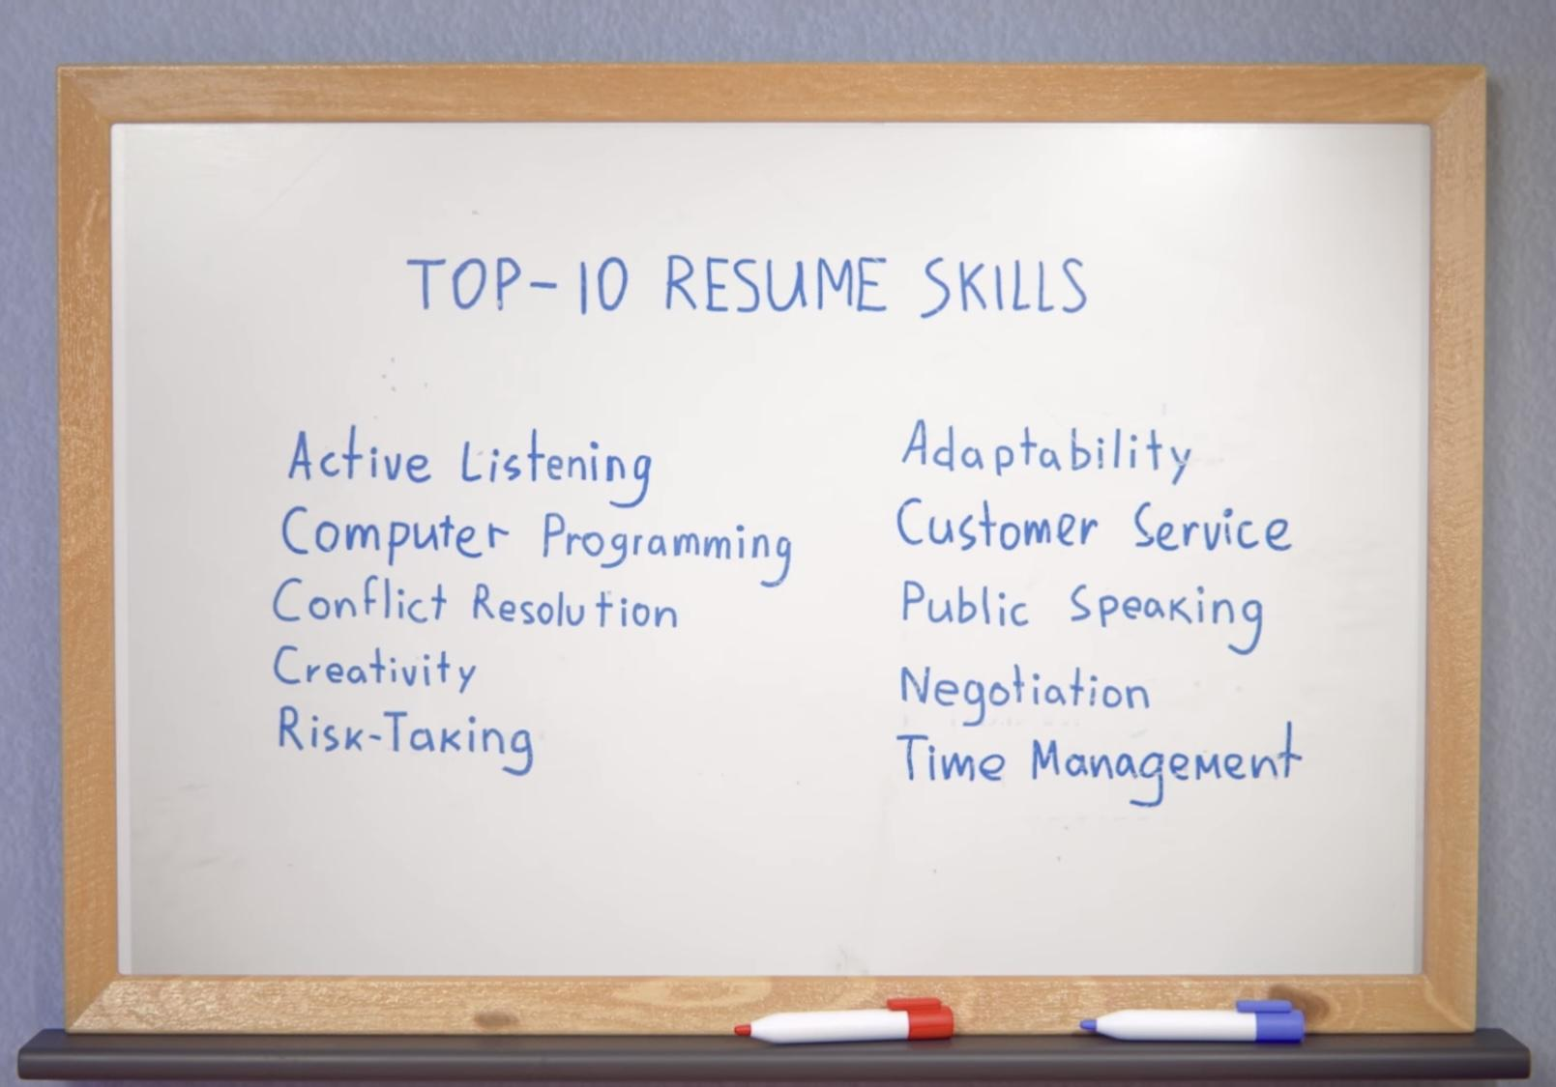
Have a look at the list of top 10 resume skills. Which of them are soft skills or hard skills?
Do you have any of the mentioned skills? Why may they be useful to your future employer?

Slide 11
Match the phrases and their meanings
To shift a situation in some area, activity, sphere to a noticeable degree
Within one’s area of expertise or interest
The main thing is…
To think in an original or creative way
An expert on a particular subject whose ideas and opinions influence other people, especially in business
The bottom line is…
To think outside the box
To move the needle
Thought leader
It’s all in my wheelhouse

Slide 12
Do you think it’s a good or bad idea to use these phrases in your resume? Why (not)? Watch the video and check if you’re right.
The bottom line is… - the main thing is…
To think outside the box - to think in an original or creative way
To move the needle - to shift a situation in some area, activity, sphere to a noticeable degree
Thought leader - an expert on a particular subject whose ideas and opinions influence other people, especially in business
It’s all in my wheelhouse - within one’s area of expertise or interest

Slide 13

Were you right or wrong? Why?
What are no-no’s?
What are strong action words? Why do you need them instead?
Do you remember any strong action verbs from the video? Name them and make up your own examples.

Slide 14
Choose right words which you can use in your resume for each of the categories
communicate, instruct, audit, capture, brainstorm, earn, advance, perform, dispense, halt, architect, conceptualize, conserve, equalize, convert, collaborate, code, deploy, generate, automate, convey
To convey your communication skills:
For creative positions:
For financial gigs:
For sales:
For tech positions:

Slide 15
Use the words and speak about your skills and experience
communicate, instruct, audit, capture, brainstorm, earn, advance, perform, dispense, halt, architect, conceptualize, conserve, equalize, convert, collaborate, code, deploy, generate, automate, convey

Slide 16

Do you know this movie? What is this about?
Look at the motto. Do you agree with this? Why (not)?

Slide 17

Watch the video till 0:59 and answer the questions
1) What position is he applying for?
2) Why does he want the position?
3) Who did he call about the “tech stuff”?
4) Which positive qualities does he mention?
5) Where is the company based in?
6) According to Ben, when do musicians retire?

Slide 18

What can you do after this lesson?
I learned:
the differences between soft and hard skills
The verbs which are better to use in the resume
Notes:
Развернутый комментарий

Slide 19
Useful links:
Videos:
Top Resume Skills
Resume Words to Include and Avoid
The Intern | Full Movie Preview | Warner Bros. Entertainment
Words from this lesson:
Glossary 4

Slide 20
Thank you!

